Slide 1
Learning Session 1
Process Mapping Activities I and II

Slide 2

The presence of the Laboratory African Regional Collaboration (LARC) logo on slides
indicates that content (in whole or in part) originates with the LARC Program

Slide 3
Rationale
Mapping a process (all the steps from the beginning to the end of an activity) is a tool that allows analysis and optimization of workflow and service delivery.
In this activity, participants will map and create a table analyzing the TB/HIV diagnostic cascade.
LARC Learning Session I PowerPoint

Slide 4
Guiding Principles for Quality Assurance
Focus on the needs of the users
Focus on processes to increase the productivity of work
Use data to improve services
Use teams to improve quality
Improve communication
LARC Learning Session I PowerPoint

Slide 5
Process
“A series of actions or steps taken in order to achieve a particular end”
LARC Learning Session I PowerPoint

Slide 6
Mapping the Process
“Visual depiction of a sequence of events to build a product or produce an outcome”
LARC Learning Session I PowerPoint

Slide 7
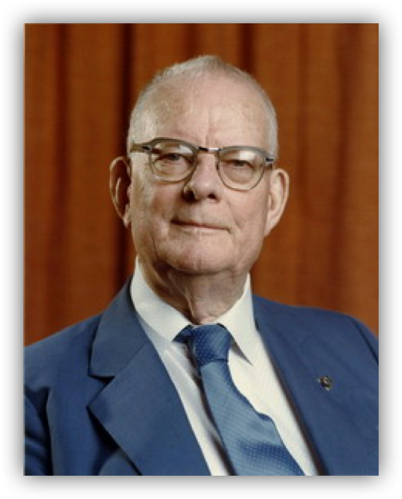
"The first step in any organization is to draw a flow diagram (process map) to show how each component depends on others. Then everyone may understand what their job is. If people do not see the process, they cannot improve it."
                W Edwards Deming (1900-1993)
LARC Learning Session I PowerPoint

Slide 8
TB/HIV PATIENT DIAGNOSTIC CASCADE
TB
Screening
Specimen collection
Specimen Transport
Laboratory Testing
Result Transmission
Treatment Initiation
Notes:
© Copyright Showeet.com – Free PowerPoint Templates

Slide 9
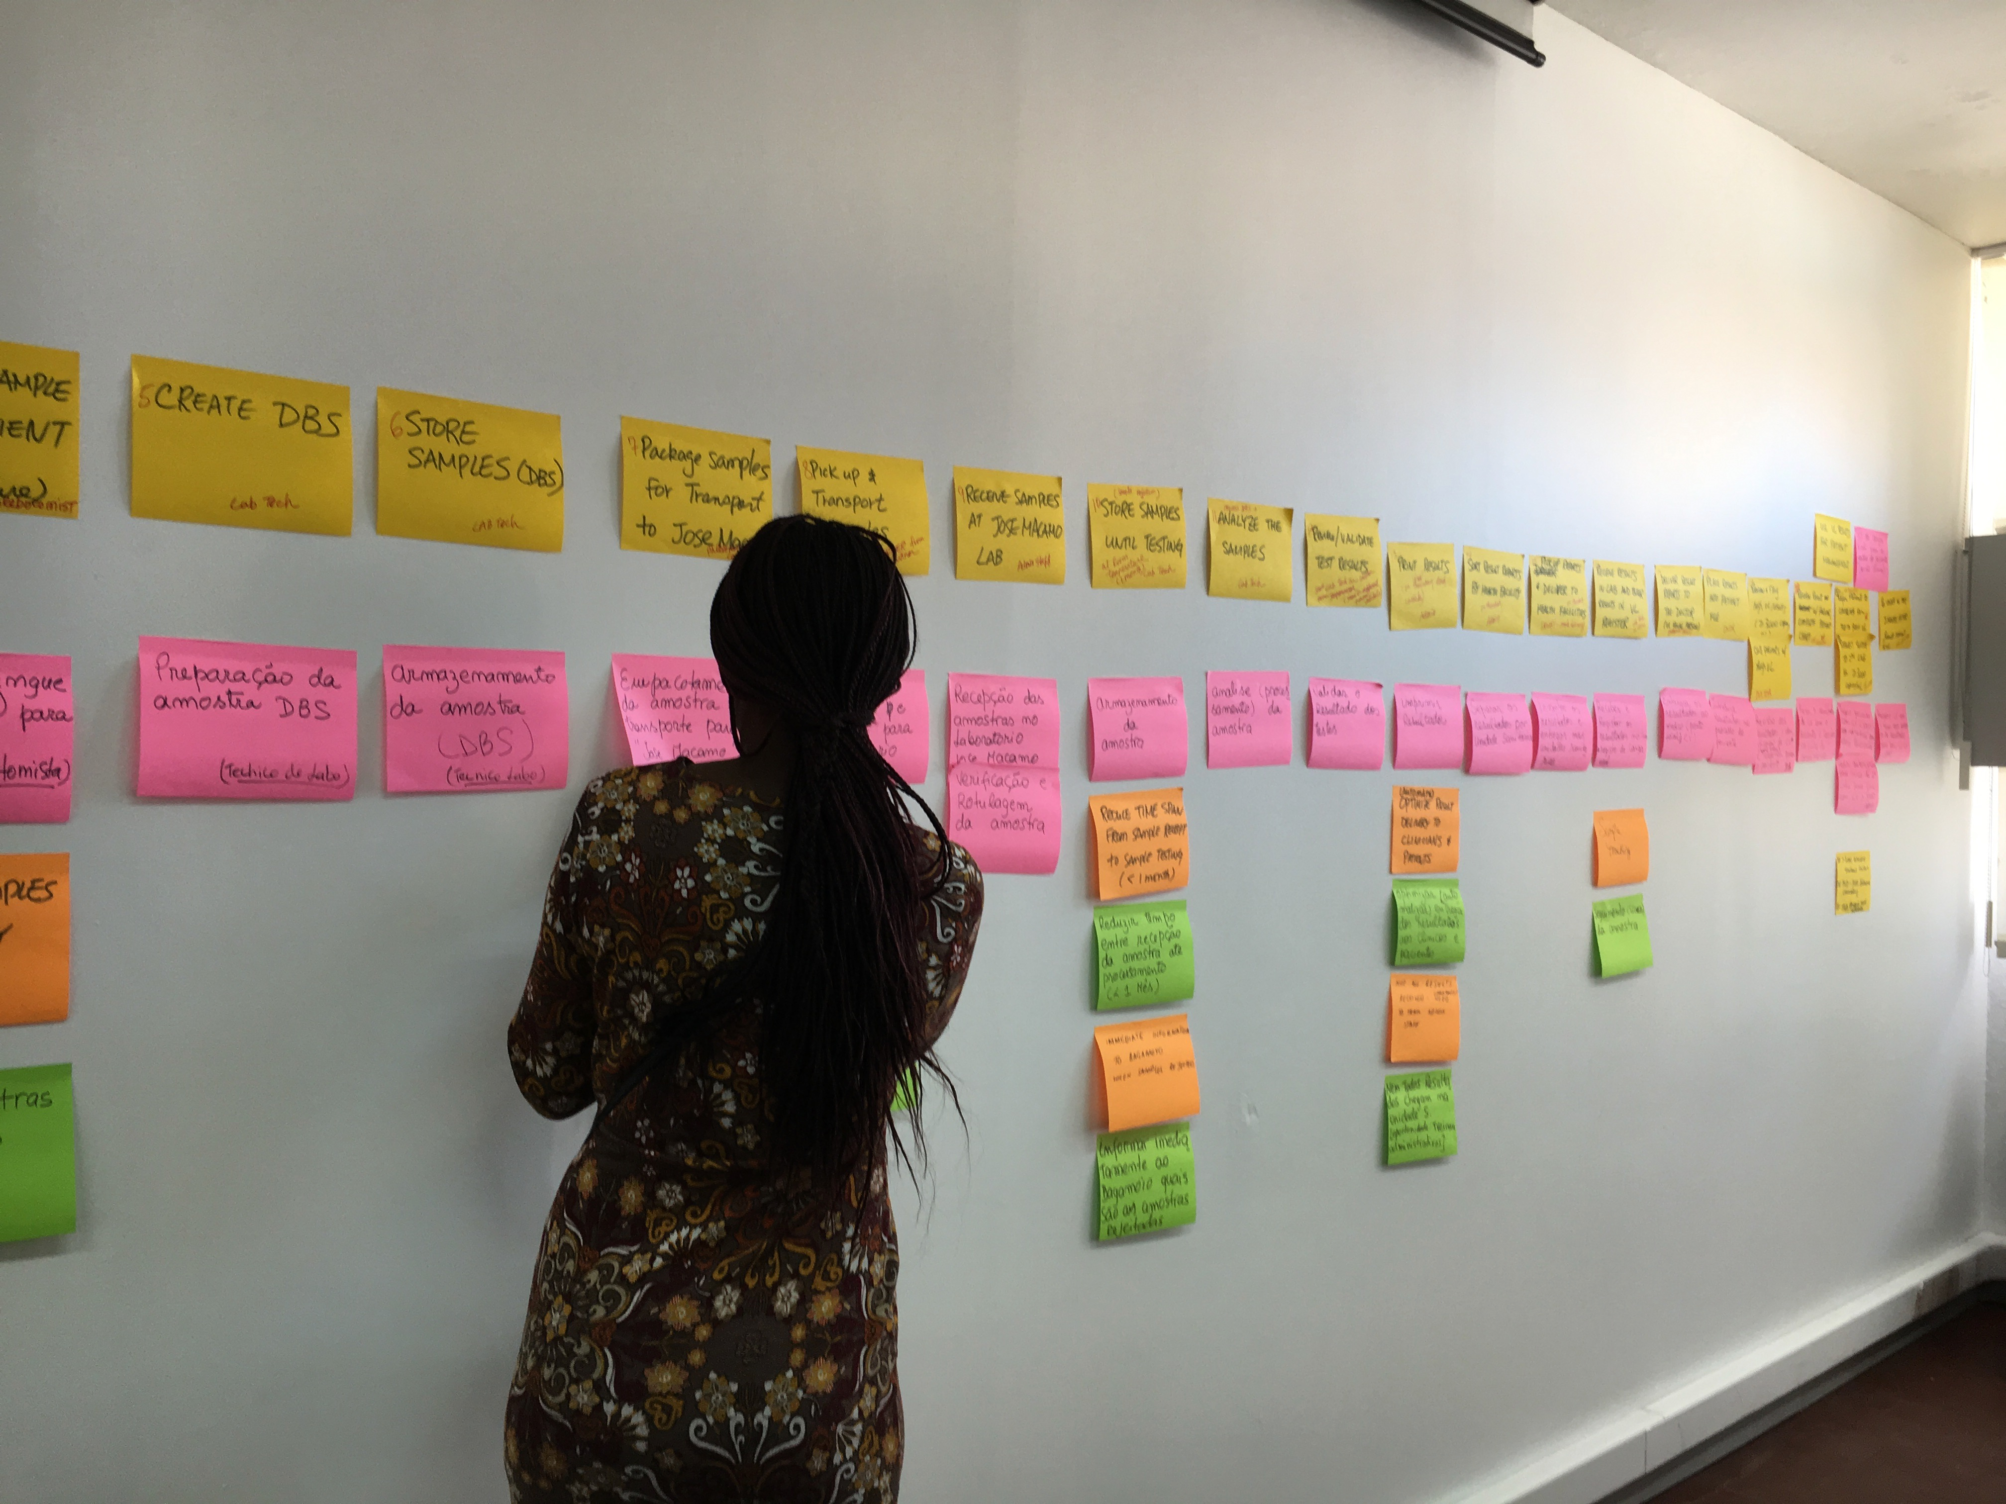
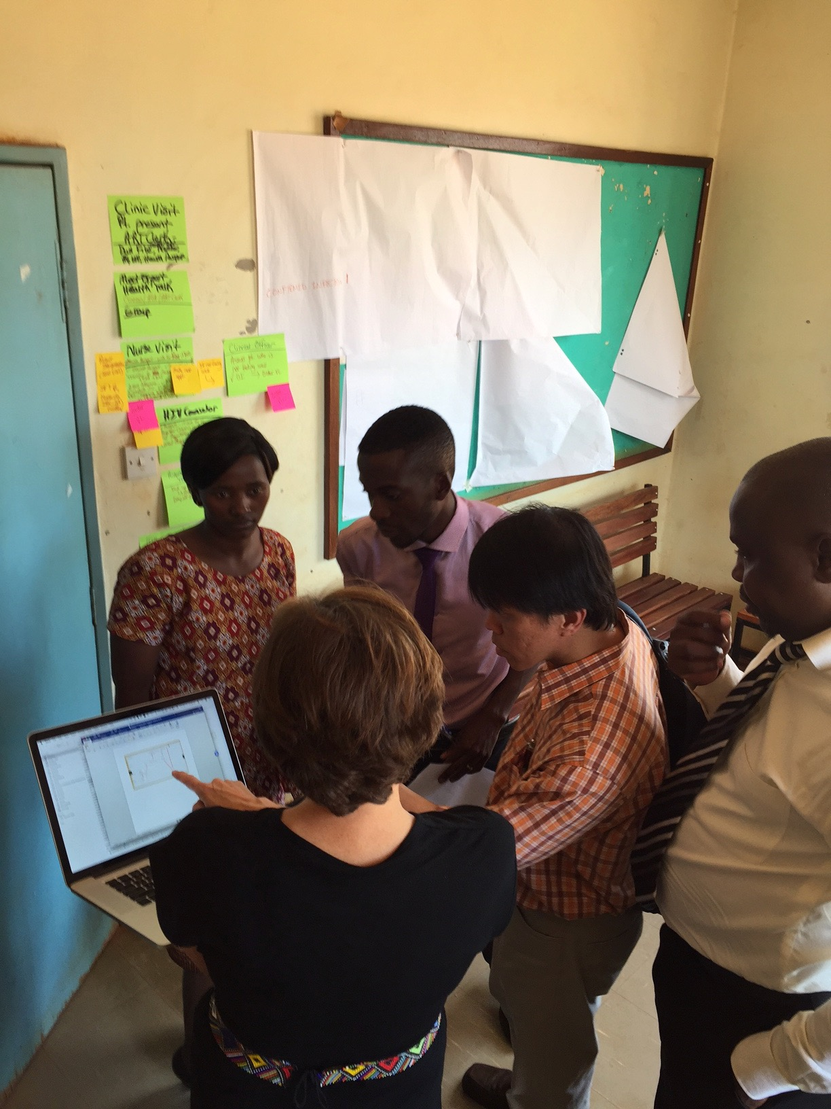
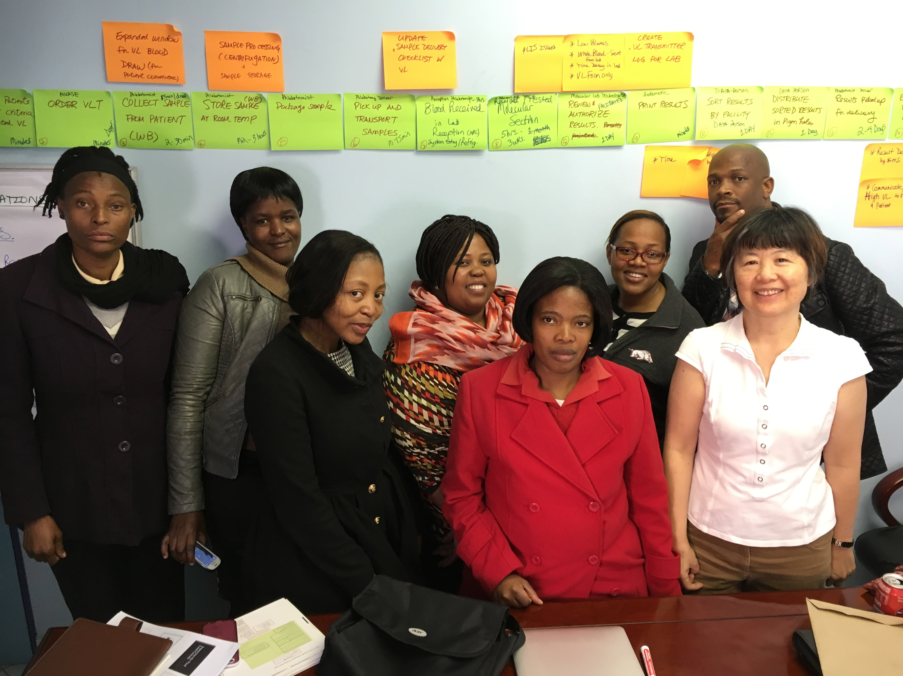
Process Mapping
LARC Workbook P. 38-40
https://www.larccqi.org/uploads/resources/LARC-3.0-WORKBOOK.pdf
LARC Learning Session I PowerPoint

Slide 10
STEPWISE Process mapping - A visual documentation (picture)
of the sequence of steps in any process
Plan
Draft Process Map & Table
Go & See
Update Process Map & Table
LARC Learning Session I PowerPoint

Slide 11
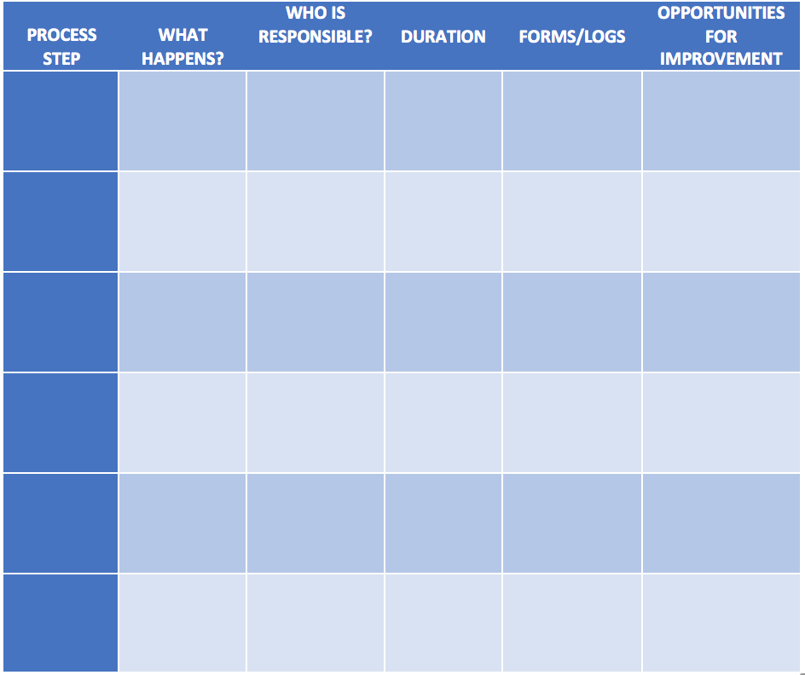
Process Mapping Guide
Pages 38-40: LARC Workbook
https://www.larccqi.org/uploads/resources/LARC-3.0-WORKBOOK.pdf
LARC Learning Session I PowerPoint

Slide 12
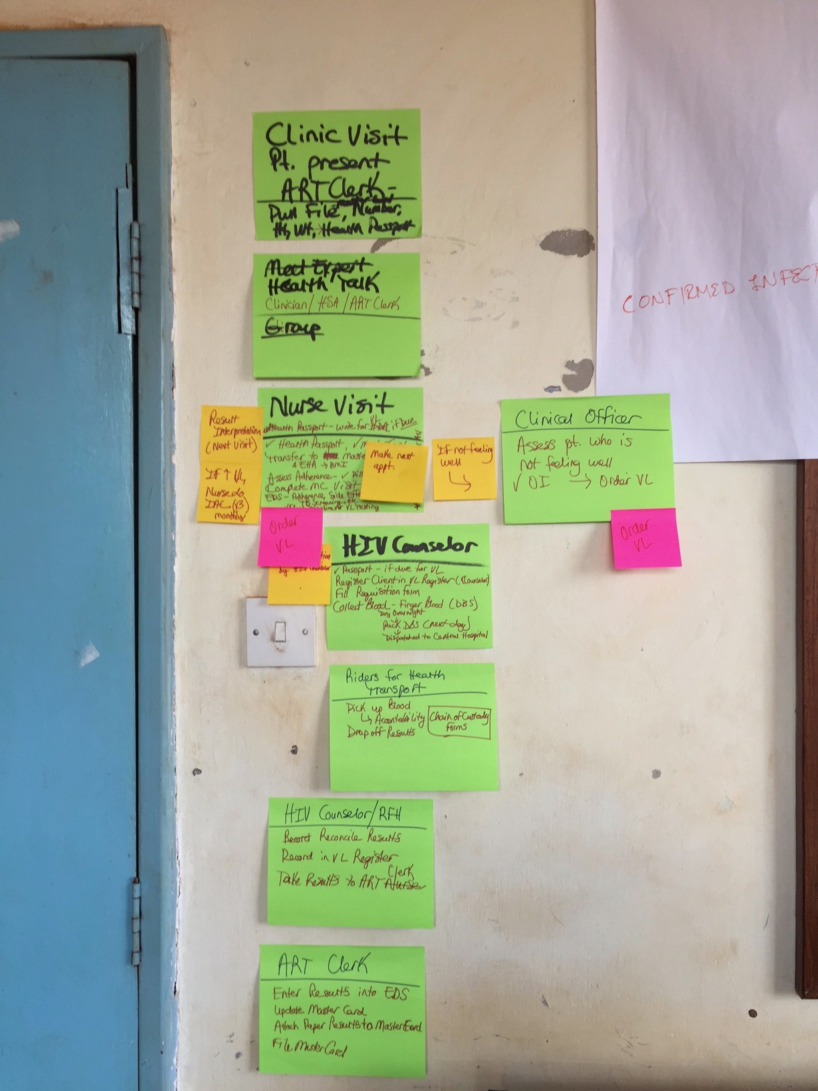
Process Mapping
Step 1 – Process Steps
  Develop a first draft of the process map using post-it-notes
    Begin by obtaining the high-level steps in the process
    Allow all cadres an opportunity to share their perspectives on the process
  Complete draft process table by identifying:
    What happens at each step
    Who performs the activities
    Time for each step (approximate range)
    Documents/Forms for each step
    Identify “Opportunities for Improvement” (OFIs)
LARC Learning Session I PowerPoint

Slide 13
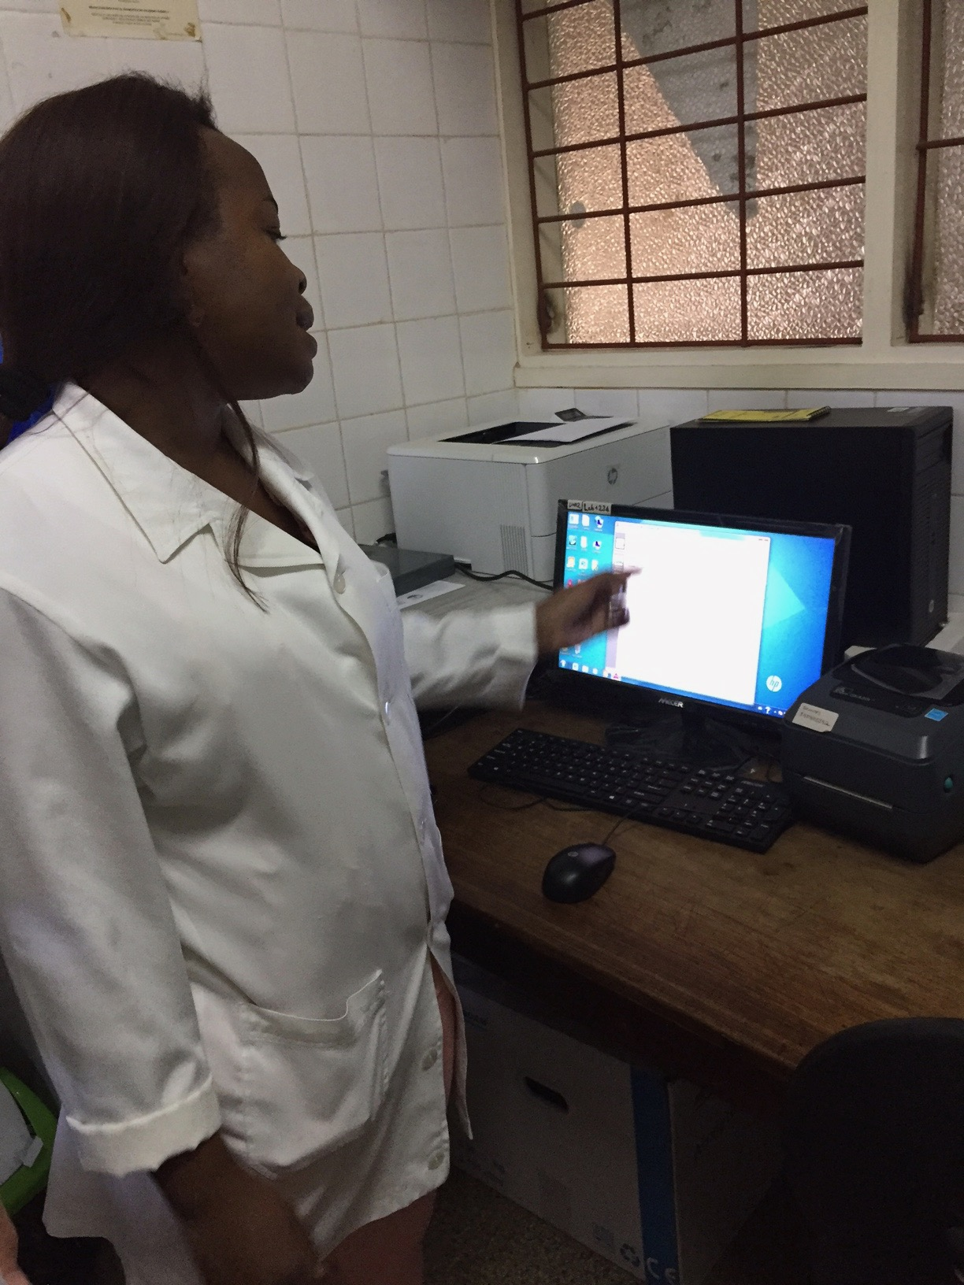
Process Mapping
Step 2 – Go & See
Observe the care process to validate the process map
    Walk to observe each step of the process
    Speak to the person who performs the process step
    Ask the person:
      “What happens here?”
      “Who is responsible?”
      “Approximately, how long does it take?”
      “What forms are needed?”
    Record your findings in the Process Table
    Look/Listen & Record all OFIs
    Move to the next step in the process
Each team member will record the process steps (process table) and any OFIs (post-it-notes)
LARC Learning Session I PowerPoint

Slide 14

Process Mapping
Step 3 – Update Process Map
  Using the collected information, validate or update as needed the draft process map
  Using the collected information, validate or update as needed the draft process table
  Create an electronic version of the Process Table (e.g., PowerPoint or Visio)
  Circulate to team members to assure accuracy and a clear representation of the current process
LARC Learning Session I PowerPoint

Slide 15
Activity: Process Mapping – Part I
Order the Steps
Purpose
To map the ‘Patient TB and TB/HIV diagnostic cascades.'
To use this mapping tool to increase the productivity and efficiency of clinic and laboratory interactions.
What will you need?
Testing Phase Cards (one set per group)
Process Step Cards (one set per group)
Tape
What will you do?
  Form groups of 7 or less persons
  Arrange the phases of Diagnostic cascades from beginning to end, in the order that they occur in the system
  Attach the cards to the wall with tape in order, from left to right horizontally across the wall
10 minutes
LARC Learning Session I PowerPoint

Slide 16
INPUTS, OUTPUTS, OUTCOMES, QUALITY INDICATORS FOR EACH PHASE

Slide 17
Activity: Process Mapping – Part II
Complete the Table
Purpose
To complete the process table by identifying, for each step in the process (4 categories):
What happens and where
Who’s responsible
What documents are needed
Pitfalls
What will you need?
A set of plain process table cards for each group
Tape
What will you do?
  Each group to complete their process table cards for the 4 categories with relevant information using the example provided
  Tape the cards to the wall to complete the table, aligning the category cards with the corresponding step
30 minutes
LARC Learning Session I PowerPoint

Slide 18
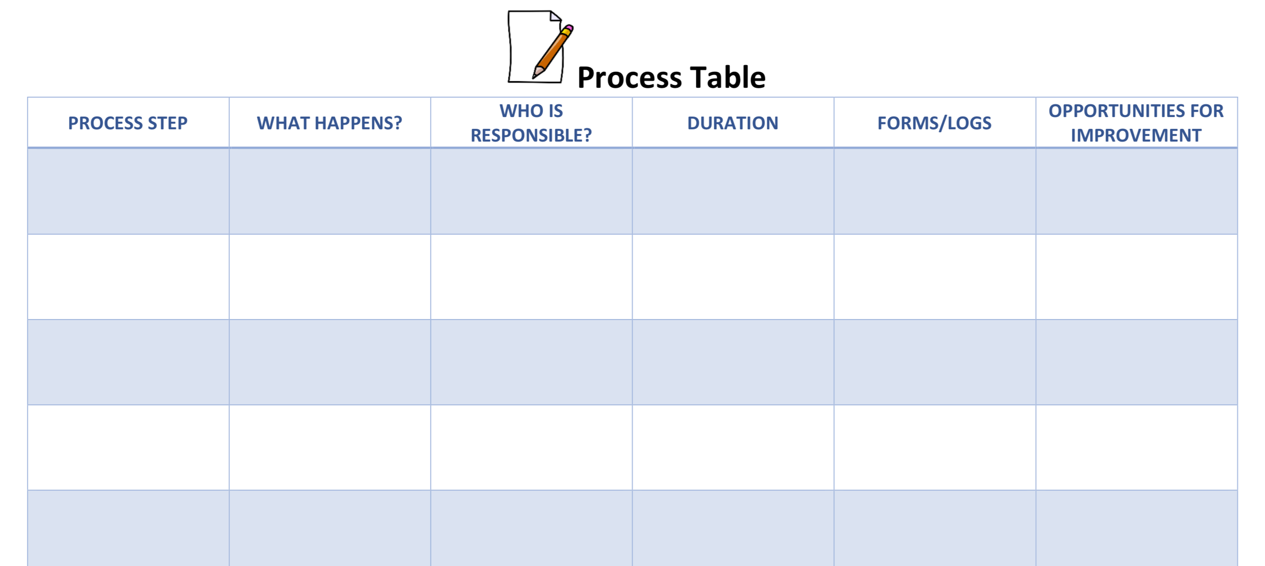
Process Table Template
LARC Learning Session I PowerPoint

Slide 19
Example Process Table
Step | What happens & where? | Who’s responsible? | Procedures needed? | Pitfalls
1.Order placed | Clinician determines need | Clinician | Ordering protocols | Unauthorized person ordering Inappropriate order
2. Patient presents to DOTS | Clinician interacts with patient | Clinician | Customer Service Specimen Collected | Lack of timely service Interaction not client-friendly
2. Clinician provides specimen to laboratory | Specimens (properly stored) are provided to laboratory for testing | Clinician Laboratorian | Cold Storage Communication Documentation | Improper storage Poor documentation Improper test
LARC Learning Session I PowerPoint

Slide 20
Summary
Mapping and analyzing processes are useful management tools. They provide an organized method of improving flow and evaluating issues that arise within, and between, clinics and laboratories.
Any process may be mapped, not just patient or specimen flows.
The use of standardized procedures prevents variation in the system; thereby avoiding many pitfalls.
Other discussion points
LARC Learning Session I PowerPoint

Slide 21
References
WHO Laboratory Quality Management System: Handbook
SLMTA Program
Global Laboratory Initiative –Training Modules for Xpert MTB/RIF Ultra
https://www.who.int/ihr/publications/lqms_en.pdf
https://slmta.org/
stoptb.org/gli/trainingpackage

Slide 22
Questions?

